Slide 1


Smartphone Price
Prediction
KUNAL DESHMUKH

Slide 2

OBJECTIVE
As mobile phone prices continue to rise, there is a growing demand for devices with specific specifications. However, consumers often lack information about the pricing of phones that meet their desired specifications.
With the progress in artificial intelligence, machine learning models are increasingly utilized and fine-tuned by providing them with training data sets.
To build the Model which will help to Predict the Price of Smartphone based on Various parameter ( independent Variable )

Slide 3






DATA PROCESS FLOW
4.PCA MODEL BUILDING
1.DATA IMPORT
2.DATA DESCRIPTION
5.LINEAR REGRESSION MODEL BUILDING
3.EXPOLATORY DATA ANALYSIS
6.CONCLUSION ON DATA

Slide 4
DATA FEATURES
Brand(brand_name) : The brand or manufacturer of the smartphone.
Smartphone Model : The name and model of each smartphone.
Price : The current market price of the smartphone.
avg_rating : ratings
5G_or_not : network
processor_brand : processor
Num_cores : cores
processor_speed : speed
battery_capacity : battery
 fast_charging_available : charging

Slide 5
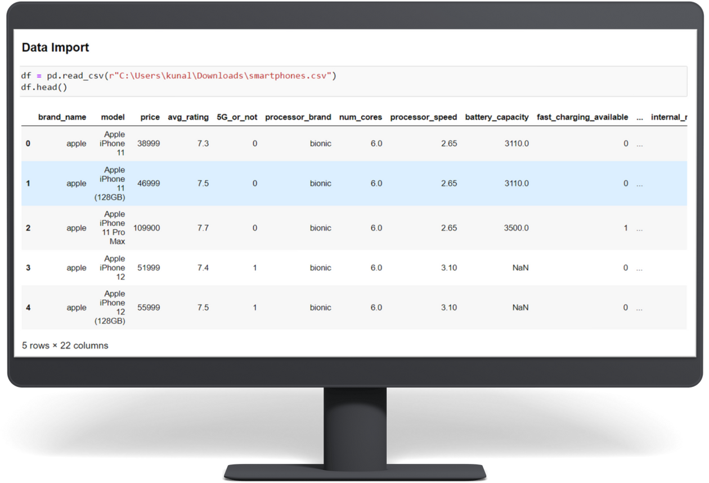
READING DATA
The first step in the data analysis process is to read in the data.
This involves loading the dataset into the analysis environment, whether that's a spreadsheet, a database, or a programming language like Python or R.
Once the data is loaded, we can begin exploring and analyzing it to uncover insights and patterns.

Slide 6
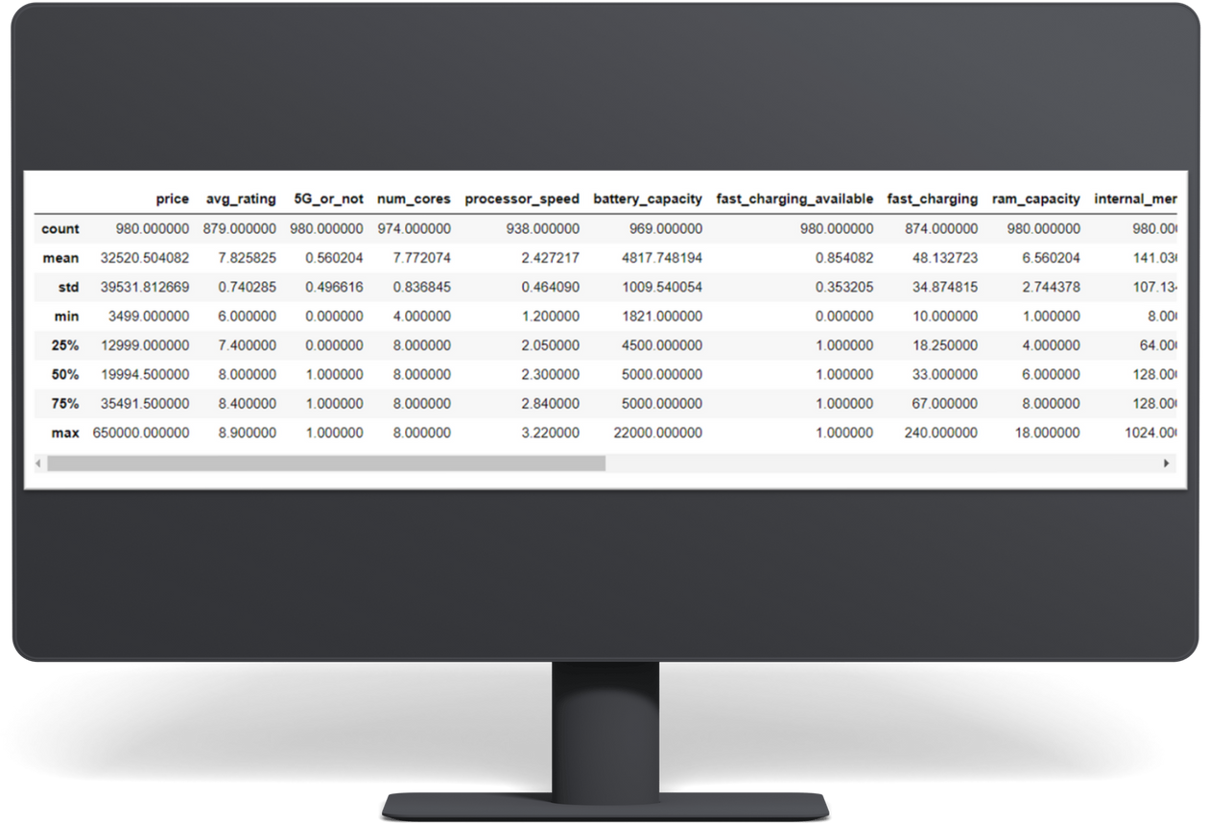
STATISTICAL INFORMATION
A visual and mathematical portrayal of information is statistics.
Data science is all about making calculations with data.
We make decisions based on that data using mathematical conditions known


Slide 7
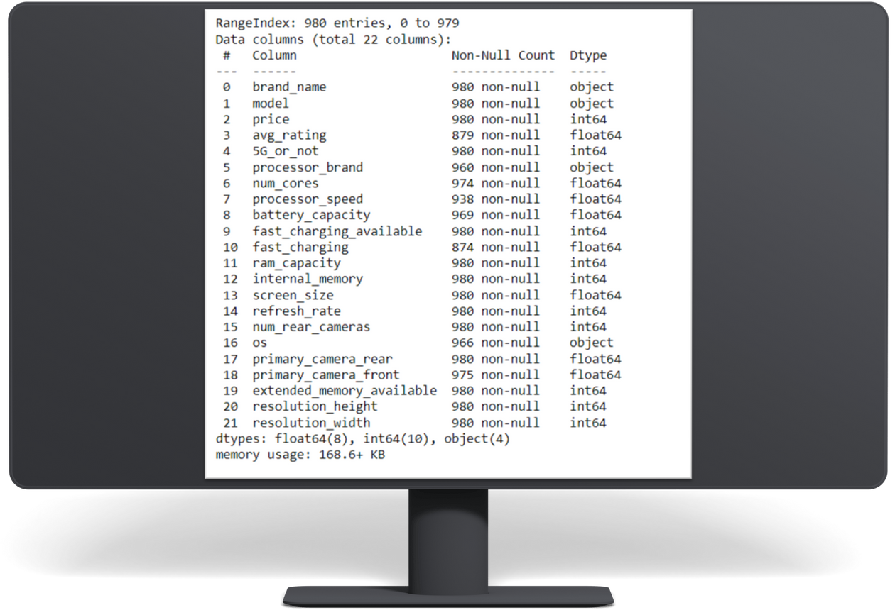
INFORMATION OF DATA📖
A visual and mathematical portrayal of information is statistics.
Data science is all about making calculations with data.
We make decisions based on that data using mathematical conditions known


Slide 8

Exploratory Data Analysis (EDA) 📊
• EDA is a step in the Data Analysis Process, where a number of techniques are used to better understand the dataset being used.
• Understanding the dataset' can refer to a number of things , the relationships between them ,handling Missing values.

Slide 9
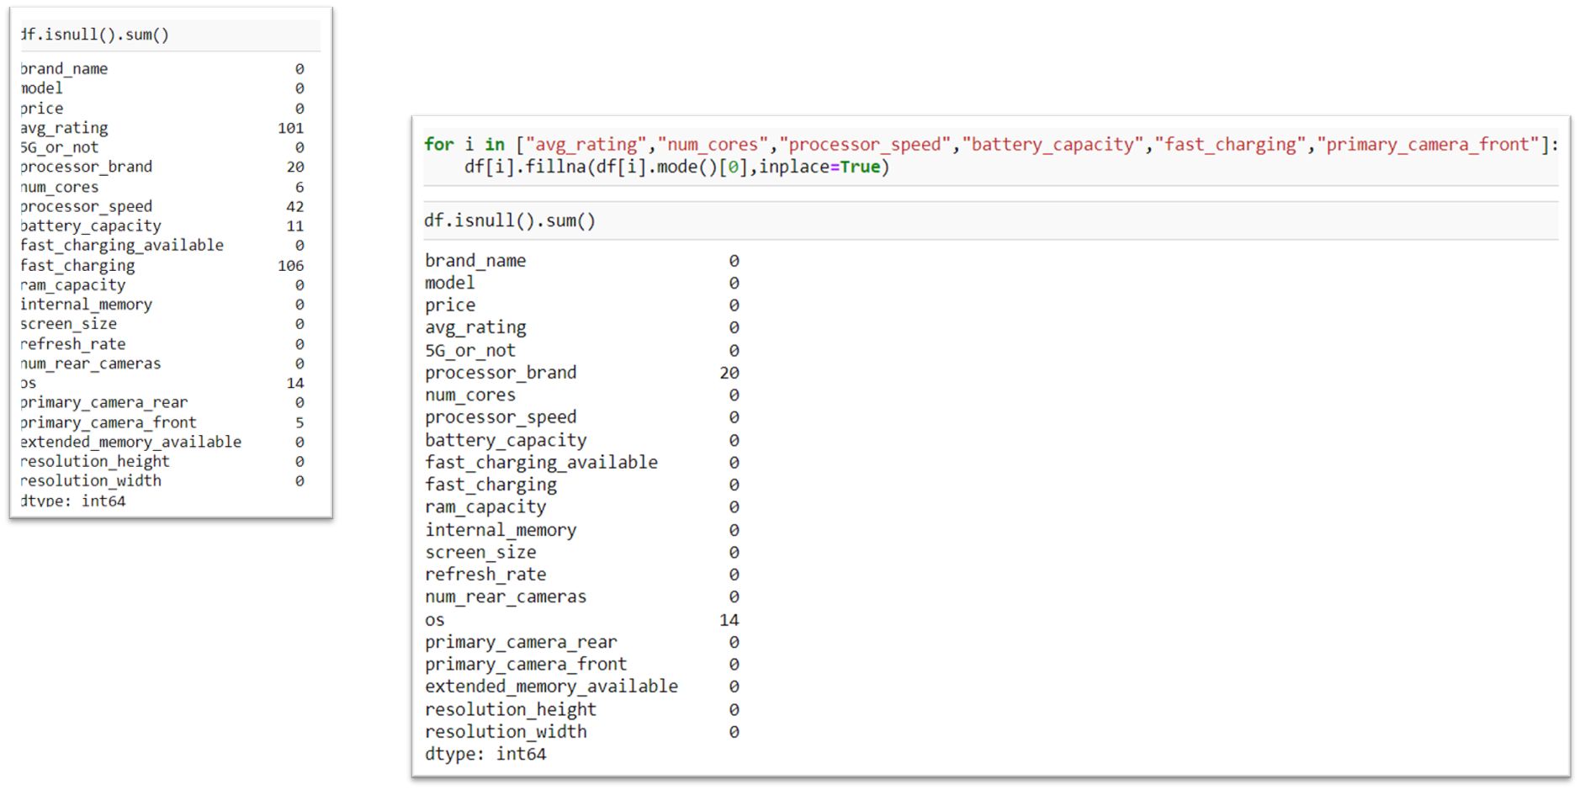
REMOVING NULL VALUES

Slide 10
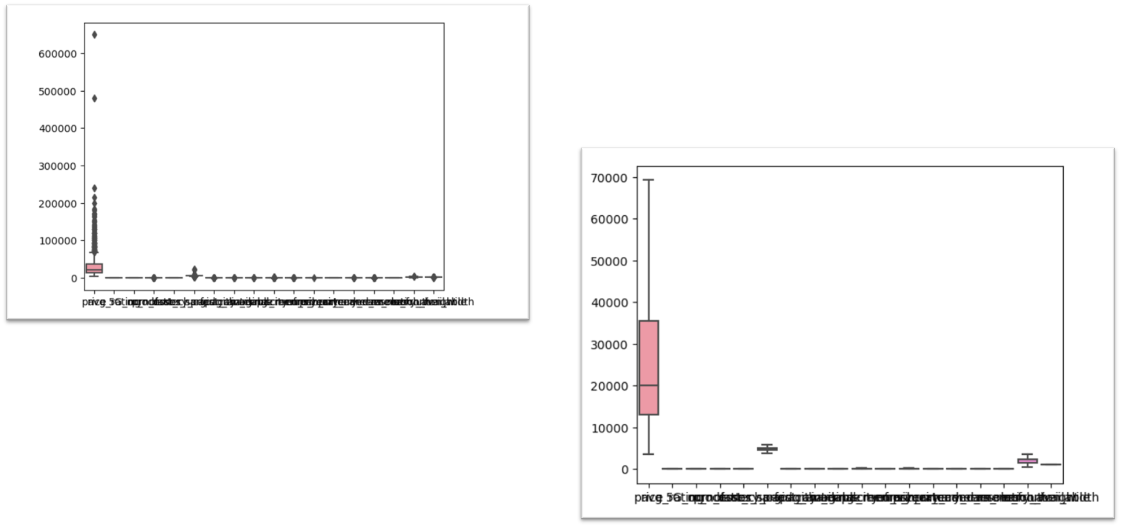
REMOVING OUTLIERS
AFTER
BEFORE

Slide 11
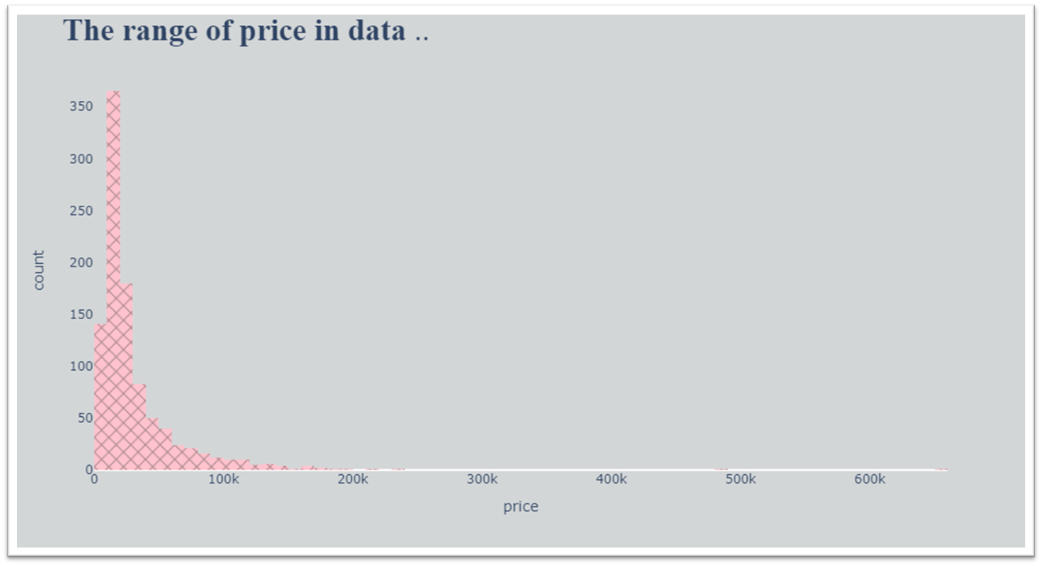
COUNT OF PRICE

Slide 12
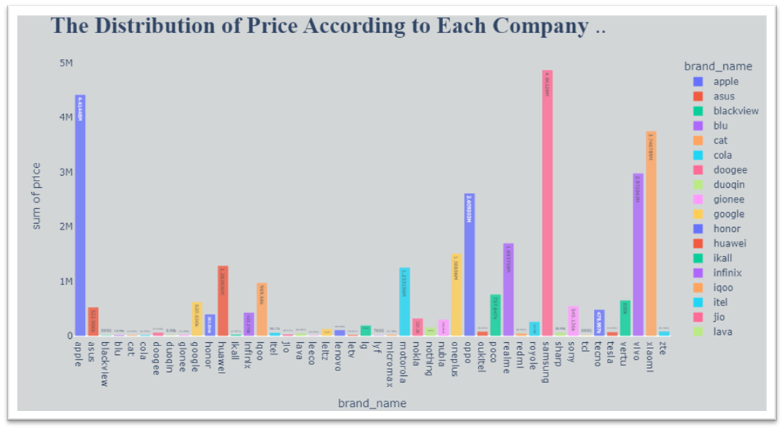
DISTRIBUTION OF PRICE ACCORDING TO EACH COMPANY
It is clear here that the top 3 price categories are Samsung then apple and finally Xiaomi

Slide 13
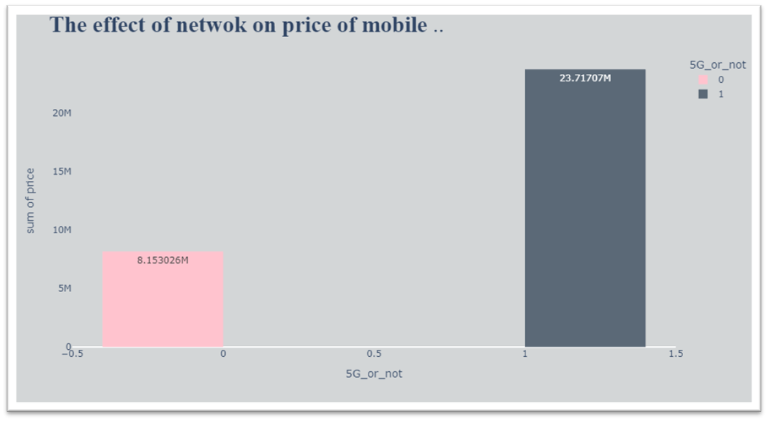
EFFECT OF NETWORK ON PRICE
Mobile phones that have a network 5G are more expensive than those without it

Slide 14
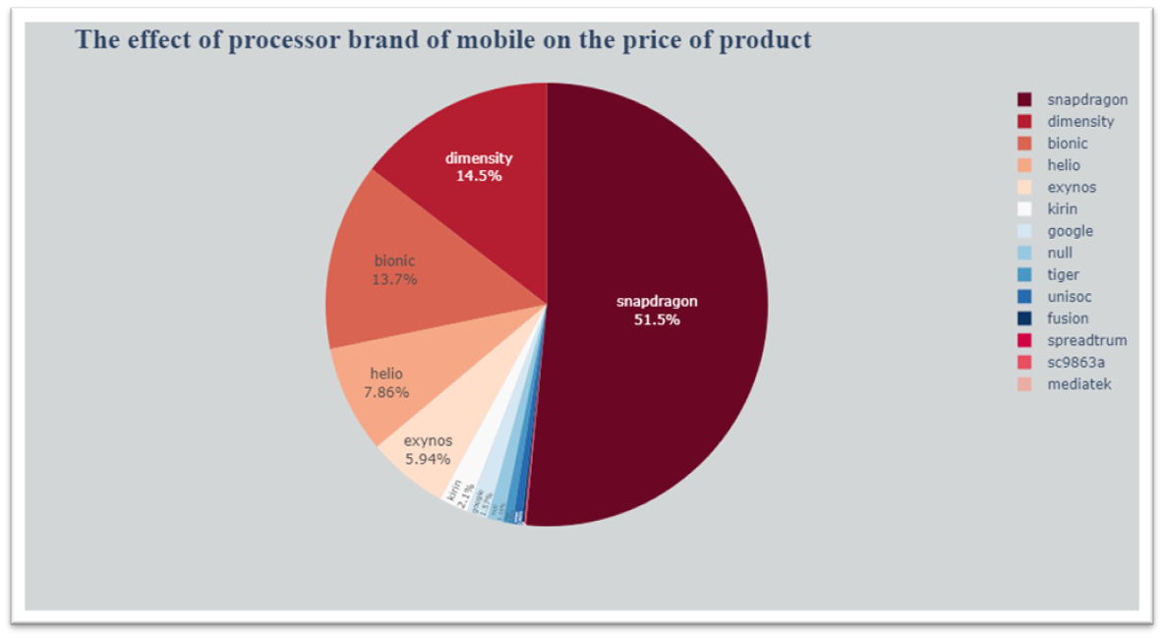
EFFECT OF PROCESSOR BRAND OF MOBILE ON THE PRICE
Snapdragon brand is the most expensive

Slide 15
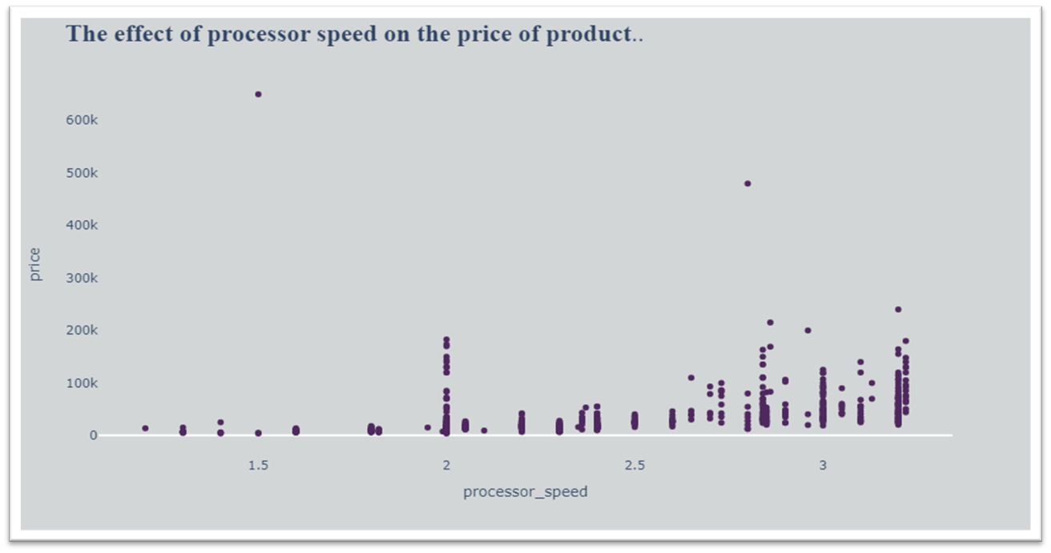
THE EFFECT OF PROCESSSOR SPEED ON THE PRICE
It is clear that the most people use the processor with speed in range 2.7 to 3.22.
the faster the processor, the higher the price of the phone

Slide 16
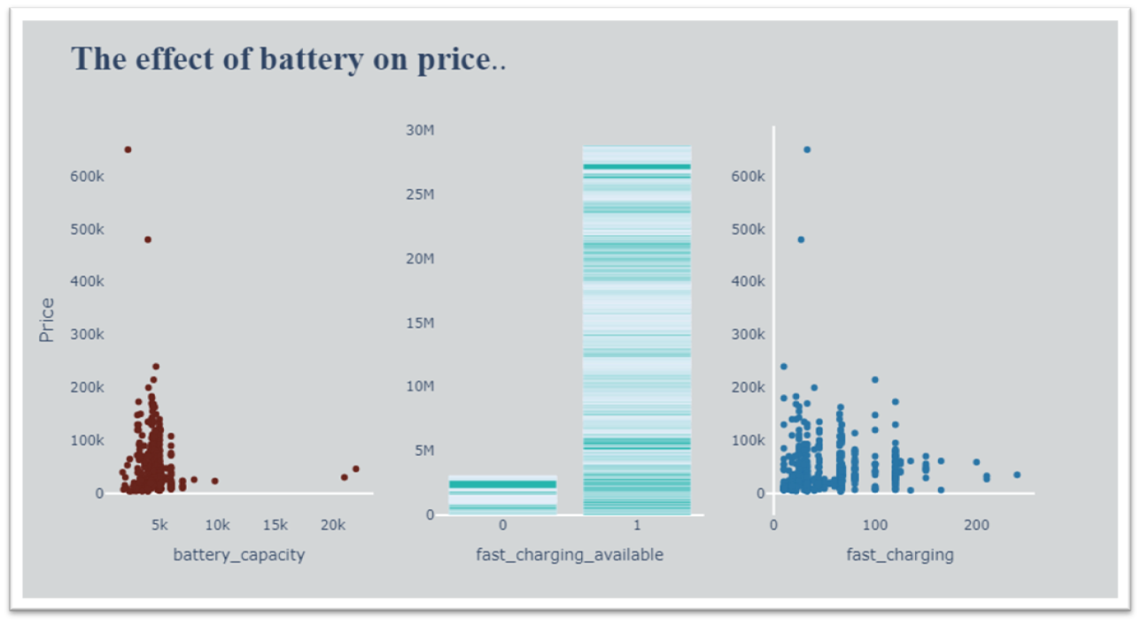
THE EFFECT OF BATTERY ON PRICE
It is clear that the most people use battery_capacity with values in range 1800:6000.
In this range , the price increases.
It is clear that the most people use fast_charging_available with high price.
It is clear that the fast_charging that used is less than 150.

Slide 17
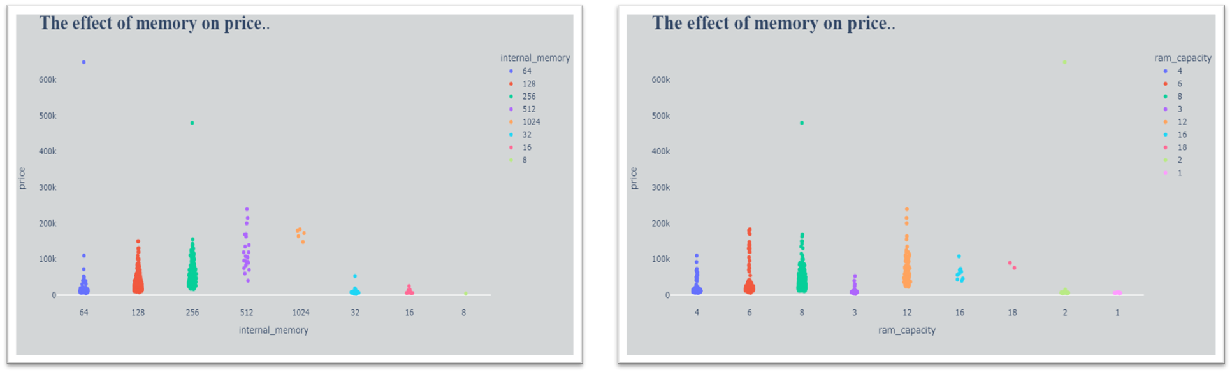
THE EFFECT OF MEMOERY ON PRICE
The highest price in terms of internal memory is 512G.
But the most used are 128G and 256G.
The highest price in terms of internal memory is 12 ram.
The most used are 6,8 ram and 12 ram.

Slide 18
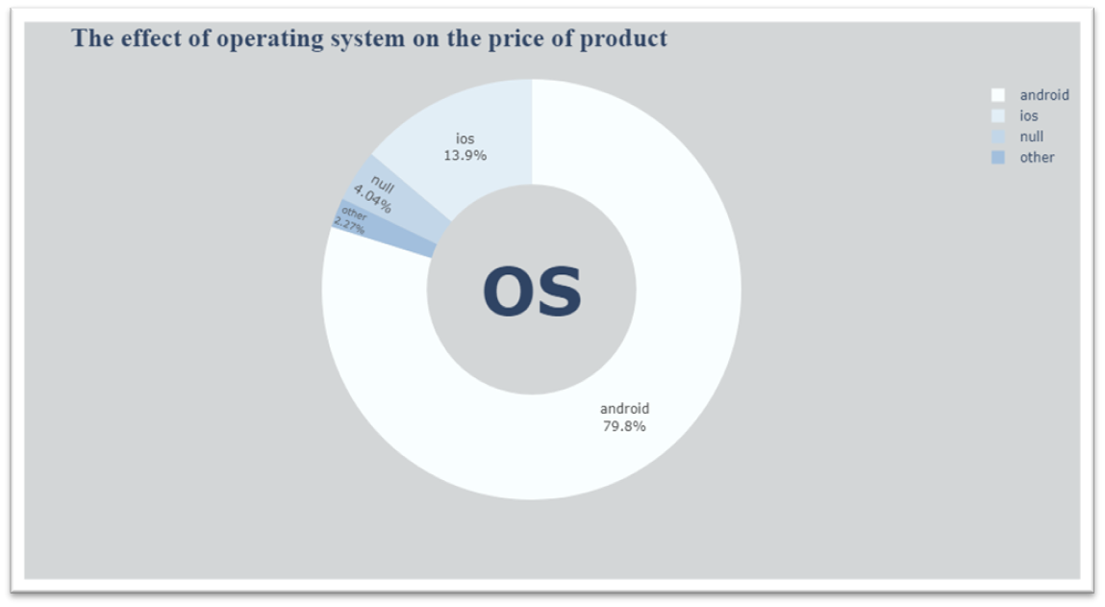
THE EFFECT OF OPERATING SYSTEM ON PRICE
Android os is most use

Slide 19
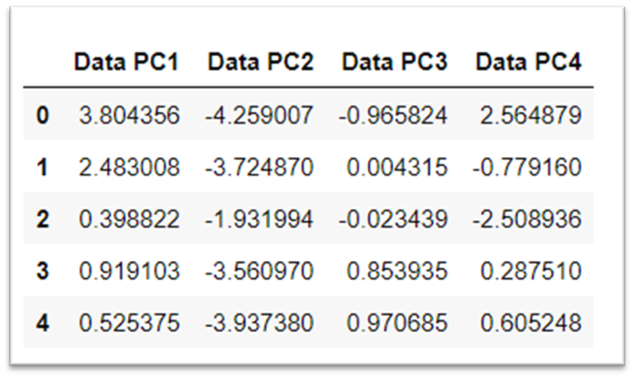
APPLYING PCA (PRINCIPLE COMPONENT ANALYSIS)
Principal Component Analysis (PCA) is a technique used to reduce the dimensionality of data while preserving as much variability as possible.
PCA helps in simplifying data, removing noise, and improving the performance of machine learning models.

Slide 20
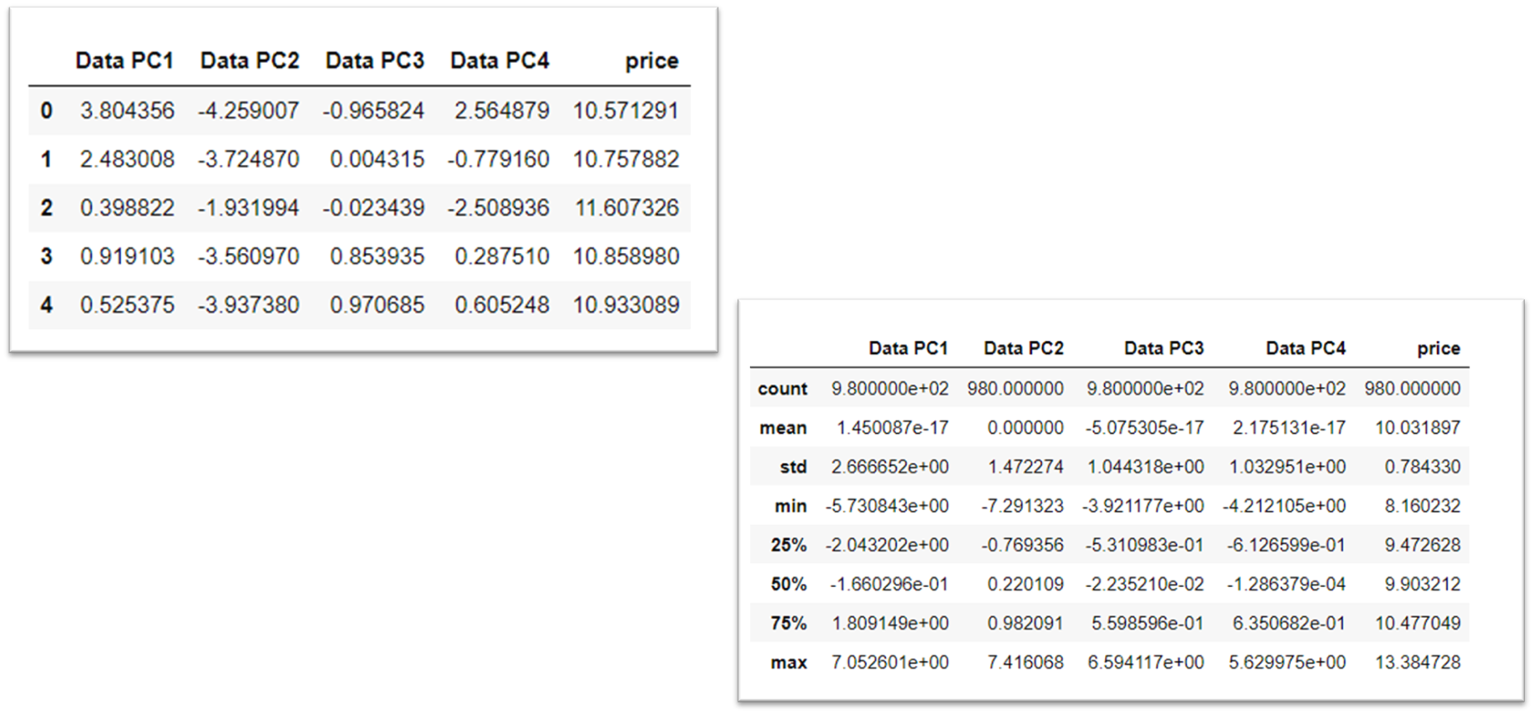
CONVERTING UNSUPERVISED TO SUPERVISED
DESCRIPTION OF SUPERVISED DATA

Slide 21
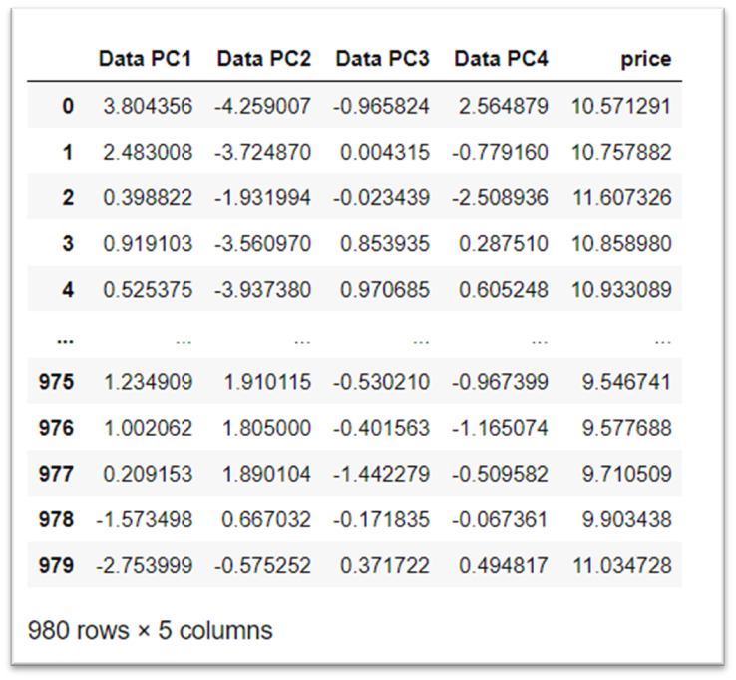
LINEAR REGRESSION
After PCA , applying linear regression on output data of PCA

Slide 22
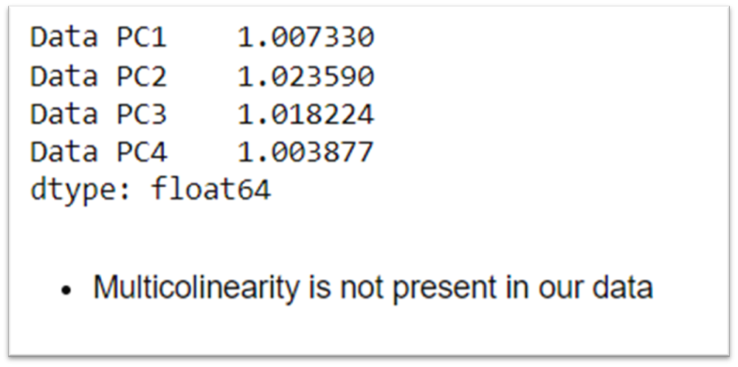
VIF(VARRIANCE INFLIATION FACTOR)
All values are nearly equal to 1.
Multicollinearity is not present

Slide 23
ASSUMPTION OF MODEL
MODEL ASSUMPTION BASED ON FOLLOWING POINTS :
LINEARITY
NORMALITY
HOMOSCEDASTICITY
MODEL ERROR INDEPENDENTLY IDENTIFIABLY DISTRIBUTED

Slide 24
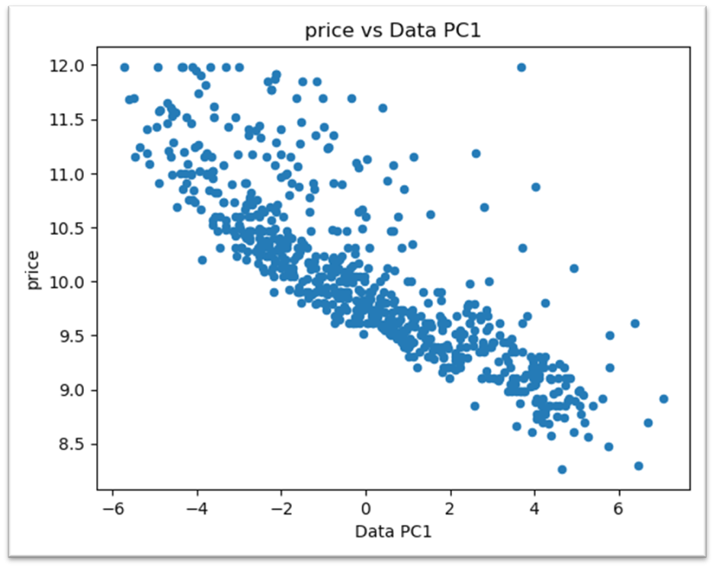
LINEARITY
The relationship between the input variables and the output is a straight line.

Slide 25
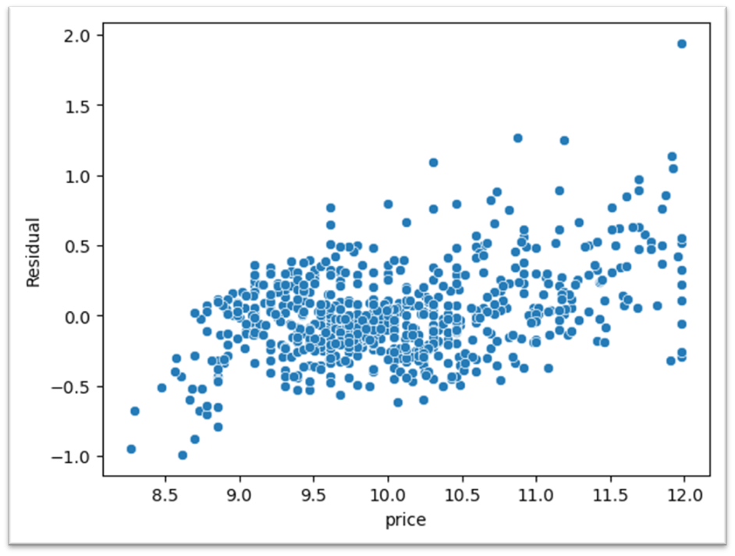
NORMALITY
The errors (differences between observed and predicted values) should follow a normal distribution.

Slide 26
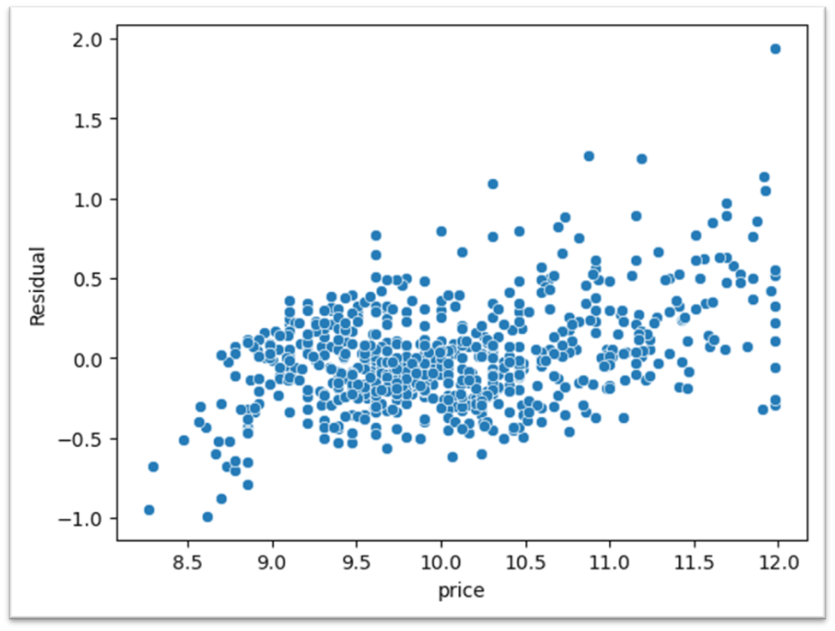
HOMOSCADATICITY
The spread of the errors should be consistent across all levels of input variables.

Slide 27
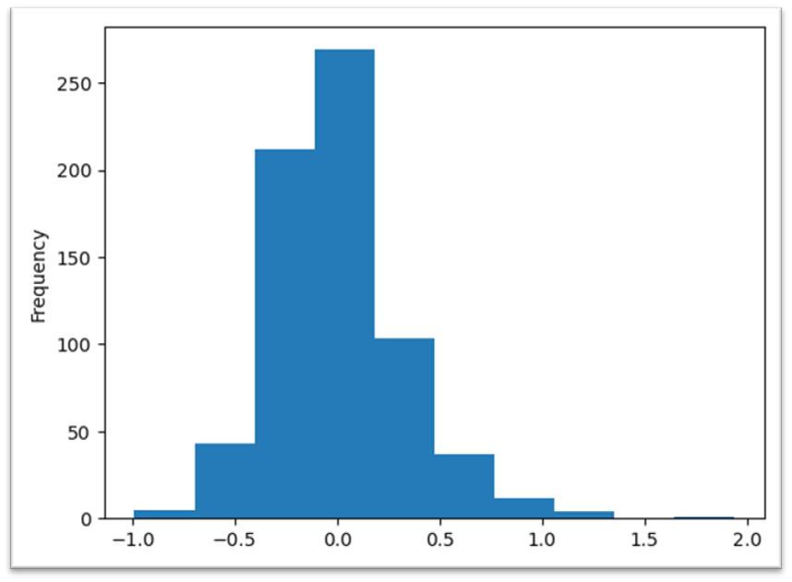
MODEL ERROR IDEPENDANTLY IDENTIFIABLY DISTRIBUTED
Errors should not influence each other and should be evenly distributed, not related to inputs.

Slide 28
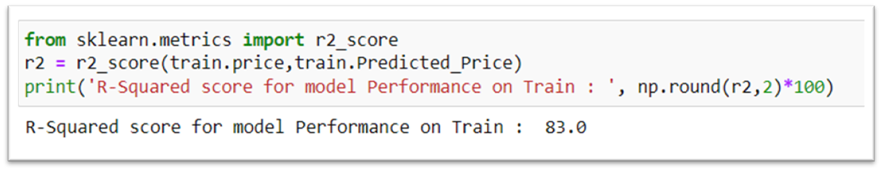
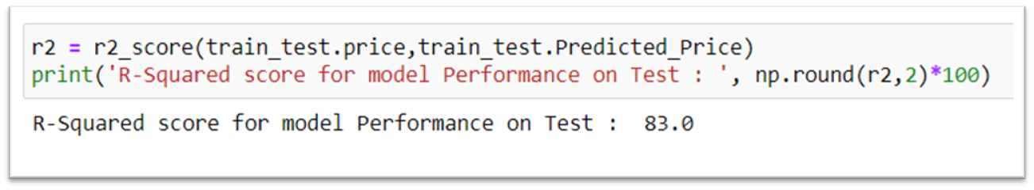
R-SQUARED ON TRAIN DATA
Accuracy of model is 83% .
Model is Good Fit on Train Data
R-SQUARED ON TRAIN DATA
Accuracy of model is 83% .
Performance of Train model on Test is also Good Fit

Slide 29
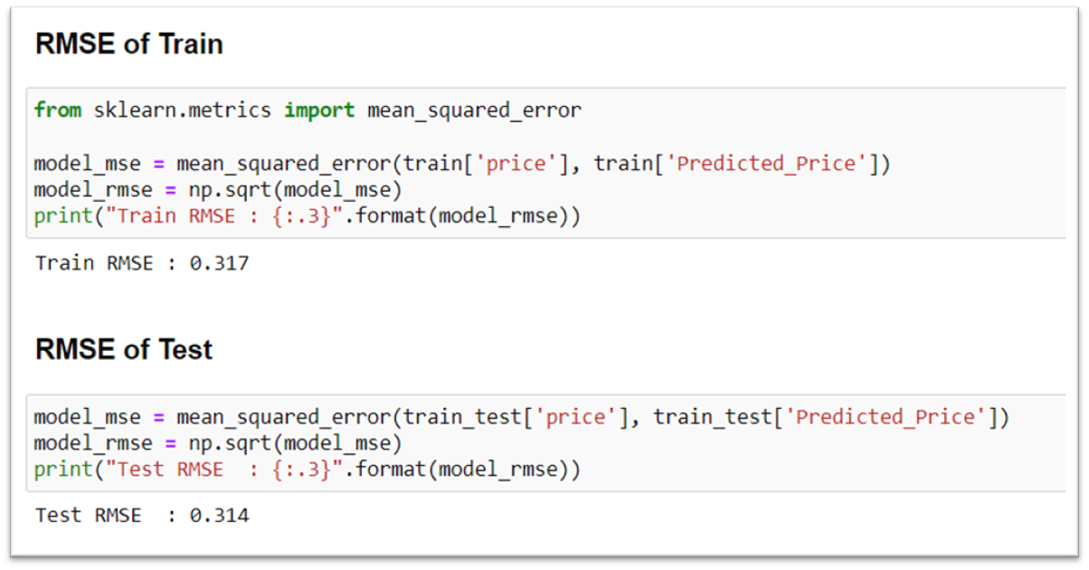
RMSE (ROOTB MEAN SQUARED ERROR)
RMSE Value of Train is 0.317
RMSE Value of Test is 0.317

Slide 30
CONCLUSION
The developed model effectively predicts smartphone prices based on various independent variables, providing valuable insights into the factors influencing pricing decisions in the smartphone market.

Slide 31
Thank You

